Slide 1
BEST PRACTICES FOR COST ATTRIBUTION, EFFICIENCY & PERFORMANCE
Bob Morrison
Sr. Solutions Architect | Snowflake

Slide 2
Safe Harbor and Disclaimers
Other than statements of historical fact, all information contained in these materials and any accompanying oral commentary (collectively, the “Materials”), including statements regarding (i) Snowflake’s business strategy, plans or priorities, (ii) Snowflake’s new or enhanced products, services, and technology offerings, including those that are under development or not generally available, (iii) market growth, trends, and competitive considerations, (iv) our vision for Snowpark, the Data Cloud, and industry-specific Data Clouds, including the expected benefits and network effects of the Data Cloud; and (v) the integration, interoperability, and availability of Snowflake’s products, services, or technology offerings with or on third-party platforms or products, are forward-looking statements. These forward-looking statements are subject to a number of risks, uncertainties and assumptions, including those described under the heading “Risk Factors” and elsewhere in the Annual Reports on Form 10-K and the Quarterly Reports on Form 10-Q that Snowflake files with the Securities and Exchange Commission. In light of these risks, uncertainties, and assumptions, the future events and trends discussed in the Materials may not occur, and actual results could differ materially and adversely from those anticipated or implied in the forward-looking statements. As a result, you should not rely on any forwarding-looking statements as predictions of future events. Forward-looking statements speak only as of the date the statements are first made and are based on information available to us at the time those statements are made and/or management's good faith belief as of that time. Except as required by law, we undertake no obligation, and do not intend, to update the forward-looking statements in these Materials.
Any future product or roadmap information (collectively, the “Roadmap”) is intended to outline general product direction. The Roadmap is not a commitment, promise, or legal obligation for Snowflake to deliver any future products, features, or functionality; and is not intended to be, and shall not be deemed to be, incorporated into any contract. The actual timing of any product, feature, or functionality that is ultimately made available may be different from what is presented in the Roadmap. The Roadmap information should not be used when making a purchasing decision. In case of conflict between the information contained in the Materials and official Snowflake documentation, official Snowflake documentation should take precedence over these Materials. Further, note that Snowflake has made no determination as to whether separate fees will be charged for any future products, features, and/or functionality which may ultimately be made available. Snowflake may, in its own discretion, choose to charge separate fees for the delivery of any future products, features, and/or functionality which are ultimately made available.
The Materials may contain information provided by third-parties. Snowflake has not independently verified this information, and usage of this information does not mean or imply that Snowflake has adopted this information as its own or independently verified its accuracy.
© 2025 Snowflake Inc. All rights reserved. Snowflake, the Snowflake logo, and all other Snowflake product, feature and service names mentioned in the Materials are registered trademarks or trademarks of Snowflake Inc. in the United States and other countries. All other brand names or logos mentioned or used in the Materials are for identification purposes only and may be the trademarks of their respective holder(s). Snowflake may not be associated with, or be sponsored or endorsed by, any such holder(s).
Notes:
If you are planning to share these slides externally (customers, partners, prospects, events, etc.):
You must include this Safe Harbor and Disclaimers slide as the first or second slide of your presentation.
You must ensure that the “© 2025 Snowflake Inc. All Rights Reserved” footer is at the bottom of each slide.
You must ensure that all references to products and features that are not generally available are appropriately tagged as in development, in public preview, or in private preview within the slides.

Slide 3


Bob Morrison
Sr. Solutions Architect
Snowflake

Slide 4
AGENDA
Introduction
Using Tags to Attribute Costs
Warehouse Utilization
Warehouse Optimizations
Warehouse Consolidation
Performance Optimizations
Notes:
Themes
Allocating cost
Lowering cost
Increasing performance

Slide 5
Cost Attribution and Efficiency
Cost attribution using tags
Decoupling Charge backs from Warehouse configuration
More options for workload placement and thus efficiency gains
Enables
Leads to
Cost Attribution using Tags enables
More flexibility in resource sharing patterns
Greater precision in cost allocation
Notes:
Flexibility because we are no longer constrained to resources needing to be owned entirely by a cost center
Precision because its possible to identify different entities that the cost is to be allocated and slice and dice by different characteristics like prod, test etc

Slide 6
Cost Attribution

Slide 7
Scenarios
Each Team or Business Unit has a dedicated warehouse
COST_CENTER = Finance
Multiple teams share a warehouse
COST_CENTER = Finance
COST_CENTER = Central IT
COST_CENTER = Marketing
Multiple teams use an application powered by Snowflake
COST_CENTER = Finance
App powered by Snowflake
COST_CENTER = Central IT
COST_CENTER = Marketing
Notes:
Note what is not covered is

Slide 8
Steps to Set up Cost Attribution
Create a global set of tags for the organization
Map resources to business units (BUs) or teams using tags.
Map users to BUs using tags
Attribute costs depending on the resource sharing model
Notes:
Note what is not covered is

Slide 9
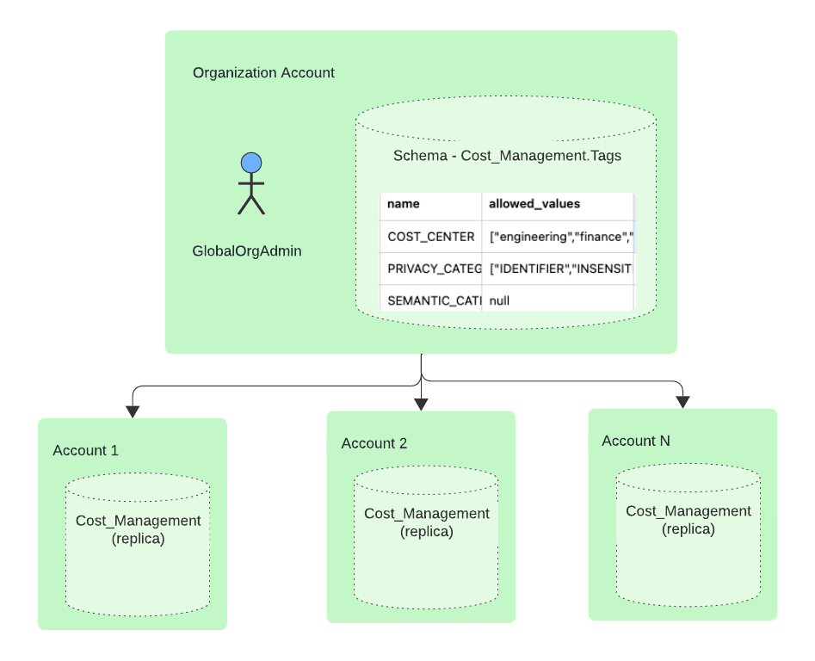
Setting up Global Tags in the Organization
Notes:
Potentially any account can be used as the Hub. Preferably though use the Org account or OrgAdmin enabled account

Slide 10
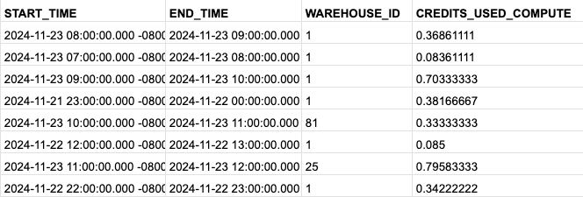
Attribution for Warehouses Used by a Single BU
SNOWFLAKE.ORGANIZATION_USAGE.TAG_REFERENCES
SNOWFLAKE.ORGANIZATION_USAGE.WAREHOUSE_METERING_HISTORY
TAG_NAME | TAG_VALUE | OBJECT_ID | OBJECT_NAME | DOMAIN
COST_CENTER | marketing | 1 | MEDIUMWH | WAREHOUSE
COST_CENTER | finance | 82 | FINUSER | USER
COST_CENTER | marketing | 81 | XLARGEWH | WAREHOUSE
COST_CENTER | engineering | 52 | BUDGETS_DB | DATABASE
COST_CENTER | finance | 1 | MEDIUMWH | WAREHOUSE
TAG_NAME | TAG_VALUE | TOTAL_CREDITS
COST_CENTER | finance | 33.04500001
COST_CENTER | marketing | 23.8163889
COST_CENTER | engineering | 4.195277786
null | untagged | 1.572777777
Notes:
This same step can be done for other resources as well

Slide 11
Attribution for Warehouses Shared by BUs
SNOWFLAKE.ACCOUNT_USAGE.TAG_REFERENCES
SNOWFLAKE.ACCOUNT_USAGE.QUERY_ATTRIBUTION_HISTORY
TAG_NAME | TAG_VALUE | OBJECT_NAME | DOMAIN
COST_CENTER | marketing | MKTUSER1 | USER
COST_CENTER | finance | FINUSER | USER
COST_CENTER | marketing | MKTUSER2 | USER
COST_CENTER | engineering | ENGUSER | USER
COST_CENTER | finance | MEDIUMWH | WAREHOUSE
QUERY_ID | USER_NAME | CREDITS_ATTRIBUTED_COMPUTE
01b497c2-0002-7539-004f-6f0 | ENGUSER | 1.014444444
01b497cf-0002-7539-004f-6f0 | FINUSER | 1.014934444
01b497c2-0002-753d-004f-6f0 | ENGUSER | 2.014734144
01b497c6-0002-753d-004f-6f0 | MKTUSER | 2.002289864
01b497c7-0002-7539-004f-6f0 | APP_USER | 0.010946824
01b497c3-0002-7539-004f-6f0 | FINUSER | 1.016666667
TAG_NAME | TAG_VALUE | TOTAL_CREDITS
COST_CENTER | finance | 3.04500001
COST_CENTER | marketing | 2.8163889
COST_CENTER | engineering | 4.195277786
Notes:
Looking at the same views in an account is easy to do

Slide 12
Attribution for Applications Shared by BUs
SNOWFLAKE.ACCOUNT_USAGE.QUERY_ATTRIBUTION_HISTORY
QUERY_ID | QUERY_TAG | USER_NAME | CREDITS_ATTRIBUTED_COMPUTE
01b497c2-0002-7539-004f-6f0700146092 | COST_CENTER=marketing | APP_USER | 1.014444444
01b497cf-0002-7539-004f-6f07001460e6 | COST_CENTER=engineering | APP_USER | 1.014934444
01b497c2-0002-753d-004f-6f07001490c6 | COST_CENTER=marketing | APP_USER | 2.014734144
01b497c6-0002-753d-004f-6f07001490de | COST_CENTER=finance | APP_USER | 2.002289864
01b497c7-0002-7539-004f-6f07001460ce | COST_CENTER=engineering | APP_USER | 0.010946824
01b497c3-0002-7539-004f-6f0700146096 | COST_CENTER=marketing | APP_USER | 1.016666667
01b497c6-0002-7539-004f-6f07001460ca | COST_CENTER=finance | APP_USER | 2.019547667
01b507e9-0002-85b5-004f-6f07001836a6 | COST_CENTER=marketing | APP_USER | 1.001011431
Query_Tag | Compute_Credits
COST_CENTER=marketing | 6.063841243
COST_CENTER=Finance | 4.021837531
COST_CENTER=engineering | 2.042547935
Notes:
Looking at the same views in an account is easy to do

Slide 13
Warehouse Utilization

Slide 14
Problem Statement
We have many warehouses in my Snowflake account. Are we using those resources effectively and efficiently?
To be able to answer that question, we first need to understand what we have defined for warehouses and how are they being used.
First you need to understand:
What is my current strategy for warehouse management and configuration?
Now you can start to analyze your utilization.
Understand Current Warehouse Strategy
Are we using the Warehouse Efficiently?
Are there optimizations that could be made to current warehouse?
Can we Consolidate warehouse for better cost management?
Have we optimized performance of queries being executed?
Better Compute Cost Optimization

Slide 15
What is Available to Determine Utilization?
What is currently available to me to assist in my understanding of current utilization?
There are a couple of methods available:
Query against Query_History
Query against Warehouse_load_history
COST_CENTER = Finance
COST_CENTER = Finance
COST_CENTER = Central IT
COST_CENTER = Marketing
COST_CENTER = Finance
App powered by Snowflake
COST_CENTER = Central IT
COST_CENTER = Marketing

Slide 16
Sample Query Using Query_History
START_TIME | WH_L(LARGE) | WH_S(XSMALL)
4/16/25 0:00 | 3
4/16/25 0:01 | 0
…
4/16/25 0:37 | 0
4/16/25 0:38 | 3
4/16/25 0:39 | 0 | 1
4/16/25 0:40 | 3 | 1
4/16/25 0:41 | 0 | 1
4/16/25 0:42 | 3 | 1
4/16/25 0:43 | 0 | 1
4/16/25 0:44 | 3 | 0
4/16/25 0:45 | 0
4/16/25 0:46 | 3
…
4/16/25 1:28 | 3
4/16/25 1:29 | 0
4/16/25 1:30 | 3 | 1
4/16/25 1:31 | 0 | 1
4/16/25 1:32 | 3 | 1
4/16/25 1:33 | 0 | 1
4/16/25 1:34 | 3 | 1
4/16/25 1:35 | 0 | 0
4/16/25 1:36 | 3
4/16/25 1:37 | 0
…
with warehouses as (select warehouse_name, warehouse_size from snowflake.account_usage.query_history where start_time <= $end_time and end_time >= $start_time and warehouse_name is not null and warehouse_size is not null and warehouse_name in ('WH_L','WH_S') qualify row_number() over (partition by warehouse_name order by warehouse_size asc) = 1 )
, wh_up as (Select warehouse_name,start_time,end_time
from (select warehouse_name, timestamp as start_time, event_action,case when event_action = 'RESUME_CLUSTER' then lag(timestamp,1) over (partition by warehouse_name order by timestamp desc) else null end end_time
from (select eh1.*,lead(eh1.event_name,1) over (partition by eh1.warehouse_name order by eh1.timestamp desc,eh1.event_name desc) event_action,lead(eh1.timestamp,1) over (partition by eh1.warehouse_name order by eh1.timestamp desc,eh1.event_name desc) event_timestamp
from warehouses w inner join snowflake.account_usage.warehouse_events_history eh1 on eh1.warehouse_name = w.warehouse_name and eh1.event_name in ('WAREHOUSE_CONSISTENT', 'RESUME_CLUSTER', 'SUSPEND_CLUSTER') ) where event_name = 'WAREHOUSE_CONSISTENT' )
where event_action = 'RESUME_CLUSTER' and start_time <= $end_time and coalesce(end_time,$start_time) >= $start_time )
, queries as (select q.warehouse_name, q.start_time, q.end_time, q.query_id
from warehouses w inner join snowflake.account_usage.query_history q on q.warehouse_name = w.warehouse_name and q.cluster_number is not null and q.start_time <= $end_time and q.end_time >= $start_time )
, wh_minutes as (select w.warehouse_name, m.minut, max(case when wu.warehouse_name is null then 0 else 1 end) is_wh_up
from minutes m inner join warehouses w on 1=1 left outer join wh_up wu on wu.warehouse_name = w.warehouse_name and m.minut between wu.start_time and wu.end_time group by all )
select * from (select warehouse_name, Time, case when is_wh_up = 0 then NULL else query_count end query_count from (select w.warehouse_name, w.minut as Time, w.is_wh_up, count(q.query_id) query_count
from wh_minutes w left outer join queries q on q.warehouse_name = w.warehouse_name and w.minut between q.start_time and q.end_time group by all ) ) pivot (sum(query_count) for warehouse_name IN (any order by warehouse_name)) order by 1;

Slide 17
Warehouse Optimizations

Slide 18
How to Use Warehouse Utilization Information
Utilized
Idle
Suspended
Auto-Suspend Settings Highlight warehouses which have large amounts of idle time and could benefit from lower suspend timeouts
Warehouse Resizing Warehouses with consistent low utilization may be targets for downsizing
Warehouse Consolidation Where appropriate, move workloads onto fewer warehouses
Notes:
There are four broad ways to improve the efficiency of warehouses using the data

Slide 19
Auto-Suspend Settings
START_TIME | WH_X(XSMALL)'
4/17/25 14:59
4/17/25 15:00 | 2
4/17/25 15:01 | 2
4/17/25 15:02 | 0
4/17/25 15:03 | 0
4/17/25 15:04 | 0
4/17/25 15:05 | 0
4/17/25 15:06 | 0
4/17/25 15:07
…
4/17/25 15:59
4/17/25 16:00 | 2
4/17/25 16:01 | 2
4/17/25 16:02 | 0
4/17/25 16:03 | 0
4/17/25 16:04 | 0
4/17/25 16:05 | 0
4/17/25 16:06 | 0
4/17/25 16:07
…
with wh_size as (select distinct warehouse_name, size as warehouse_size
from snowflake.account_usage.warehouse_events_history
where warehouse_name in ('WH_X')
and timestamp >= dateadd(day,-1,current_date)
and size is not null)
select *
from (
select ws.warehouse_name||'('||ws.warehouse_size||')' as warehouse_name
, wu.start_time, wu.number_of_queries_running
from wh_size ws
inner join snowflake.account_usage.warehouse_utilization wu
on wu.warehouse_name = ws.warehouse_name
where true
and start_time >= dateadd(day,-1,current_date)
order by start_time
)
pivot (sum(number_of_queries_running) for warehouse_name IN (ANY ORDER BY warehouse_name))
order by 1;

Slide 20
Resizing Warehouse (Up - Based on Remote Spilling)
--List of Warehouse and Queries where larger warehouse could help based on remote spilling
SELECT QUERY_ID,USER_NAME,WAREHOUSE_NAME,WAREHOUSE_SIZE,BYTES_SCANNED
,BYTES_SPILLED_TO_REMOTE_STORAGE
,DIV0(BYTES_SPILLED_TO_REMOTE_STORAGE,BYTES_SCANNED) AS SPILLING_REMOTE_READ_RATIO
FROM "SNOWFLAKE"."ACCOUNT_USAGE"."QUERY_HISTORY"
WHERE BYTES_SPILLED_TO_REMOTE_STORAGE > 0
ORDER BY SPILLING_REMOTE_READ_RATIO desc
QUERY_ID | USER_NAME | WAREHOUSE_NAME | WAREHOUSE_SIZE | BYTES_SCANNED | BYTES_SPILLED_TO_REMOTE_STORAGE | SPILLING_REMOTE_READ_RATIO
01b4d56b-0809-512e-0000-432977ddd752 | USER1 | QS_DEMO | X-Large | 9,762,088,288 | 4,840,864,415,744 | 495.88
01b4da13-0809-512e-0000-432977e59bbe | USER1 | QAS_WH | X-Small | 5,351,953,056 | 1,978,381,434,880 | 369.66
01bb10f1-090f-426e-0000-432988bb6986 | USER2 | WH_1 | X-Small | 662,703,503,236 | 1,131,678,793,728 | 1.71
01b51750-080a-38c5-0000-4329784a3096 | USERX | WH_TOM | X-Small | 53,016,688,640 | 29,528,819,392 | 0.56
01bb1c90-090f-4153-0000-432988e47232 | USER9 | WH_SALES | X-Small | 46,634,562,048 | 25,586,216,064 | 0.55
01b4f1df-0809-8d02-0000-4329780ca91e | USER100 | WH_SALES | X-Small | 55,413,436,928 | 24,319,232,992 | 0.44
01b5355f-080a-38b5-0000-4329787aa642 | USERX | WH_SALES | X-Small | 55,532,952,064 | 24,353,642,304 | 0.44
01b4f77f-0809-8d18-0000-432978174f9a | USER99 | WH_AI | X-Small | 57,400,047,616 | 24,499,846,016 | 0.43
01b5448c-090a-38c5-0000-4329789309d6 | USERT | WH_DS | X-Small | 19,689,850,880 | 7,275,856,768 | 0.37
01b53730-080a-38b5-0000-4329787d6242 | USERX | WH_Z | X-Small | 18,788,823,552 | 6,838,751,168 | 0.36

Slide 21
Resizing Warehouse (Down - Based on No Local Spilling)
--List of Warehouse that have had no local spilling in last 3 months with number of queries > 100
SELECT WAREHOUSE_NAME,WAREHOUSE_SIZE,max(start_time) LAST_USED, COUNT(1)
FROM "SNOWFLAKE"."ACCOUNT_USAGE"."QUERY_HISTORY"
WHERE START_TIME >= dateadd(month,-3,current_date())
AND CLUSTER_NUMBER IS NOT NULL
AND WAREHOUSE_SIZE != 'X-Small'
and WAREHOUSE_NAME not Like 'COMPUTE\_SERVICE\_WH\_%'
GROUP BY ALL
HAVING SUM(BYTES_SPILLED_TO_LOCAL_STORAGE) = 0 and COUNT(1) > 100
ORDER BY LAST_USED DESC;
WAREHOUSE_NAME | WAREHOUSE_SIZE | LAST_USED | COUNT(1)
TEST_DEMO_WH | Small | 4/3/25 19:30:29 | 108
TEST_M_WH | Medium | 3/21/25 0:25:01 | 629
FAKE_DATA_GENERATOR | Small | 2/28/25 23:18:17 | 1056

Slide 22
Warehouse Optimizations

Slide 23
Consolidation Based on Utilization
START_TIME | WH_L(LARGE) | WH_S(XSMALL)
4/16/25 0:00 | 3
4/16/25 0:01 | 0
…
4/16/25 0:37 | 0
4/16/25 0:38 | 3
4/16/25 0:39 | 0 | 1
4/16/25 0:40 | 3 | 1
4/16/25 0:41 | 0 | 1
4/16/25 0:42 | 3 | 1
4/16/25 0:43 | 0 | 1
4/16/25 0:44 | 3 | 0
4/16/25 0:45 | 0
4/16/25 0:46 | 3
…
4/16/25 1:28 | 3
4/16/25 1:29 | 0
4/16/25 1:30 | 3 | 1
4/16/25 1:31 | 0 | 1
4/16/25 1:32 | 3 | 1
4/16/25 1:33 | 0 | 1
4/16/25 1:34 | 3 | 1
4/16/25 1:35 | 0 | 0
4/16/25 1:36 | 3
4/16/25 1:37 | 0
…
From prior utilization queries, we can start to identify where warehouses are up and running at the same time.
Can we consolidate into fewer warehouses?
Is there excess capacity?
Are their business reasons to not consolidate?
Do the reasons justify the higher cost?
Do the warehouses need additional nodes in worst case scenarios?
What is the anticipated cost savings?

Slide 24
Performance Optimizations

Slide 25
Optimization Principles
Guiding principles of how Snowflake optimizes queries are
Scan less data
Techniques: Partition Pruning, Filter Pushdown & Pull up, Projection Pruning, Smart Scan
Join less data
Techniques: Dynamic Pruning, Bloom Filters, Join Order Optimization
Aggregate data early
Techniques: Aggregate Placement, Group-By Pushdown
Parallelize computation
Techniques: Distributed Sort, Distributed Join, Distributed Grouping
Please note, performance optimization is cost optimization (saving money!)

Slide 26
Runaway Query Prevention
Users are going to make mistakes. These mistakes can cause queries to execute for a long time. These queries utilize compute warehouses and time, meaning they cost money.
Use the STATEMENT_TIMEOUT_IN_SECONDS parameter. Default is 2 Days.
Parameter can be set at the following levels:
Account
Warehouse
User
Session

Slide 27
THANK YOU

